Slide 1

Covid-19 Datasets
Project 2- A Case Study of ETL
Team 3
Anthony Stevens, Cecilia Zhang, Neda Mehdizadeh, and Sahar Jamal
Illustration Credit: Kateryna Kon / Shutterstock

Slide 2
Extract: Data Sources
Covid-19 in USA-Number of Novel Corona Virus 2019 cases in USA from Kaggle.com 3 csv files (primary) Reference Link: https://www.kaggle.com/sudalairajkumar/covid19-in-usa?select=us_counties_covid19_daily.csv
State, County, CBSA, Country API Data from Covid Act Now (primary) Reference Link: https://apidocs.covidactnow.org/data-definitions/
API Value | CDC Community Transmission Level
0 | Low
1 | Moderate
2 | Substantial
3 | High
4 | “Unknown”
Notes:
Neda
CSV file from kaggle that utilized a tracking project with the NY Times. This included date, state, county, death, total cases, and fips … fips is Federal Information Processing System (FIPS) Codes for States and Counties. FIPS codes are numbers which uniquely identify geographic areas.
This is our API that we extracted the most current data in reference to the CDCs transmission level by county .. 0 was low to 3 being high. Mention that unknown iss.. when both case data and test positivity data are missing for at least 15 days. The CDC does not have an "Unknown" level and instead will designate a location as "Low" when case and test positivity data are missing.

Slide 3
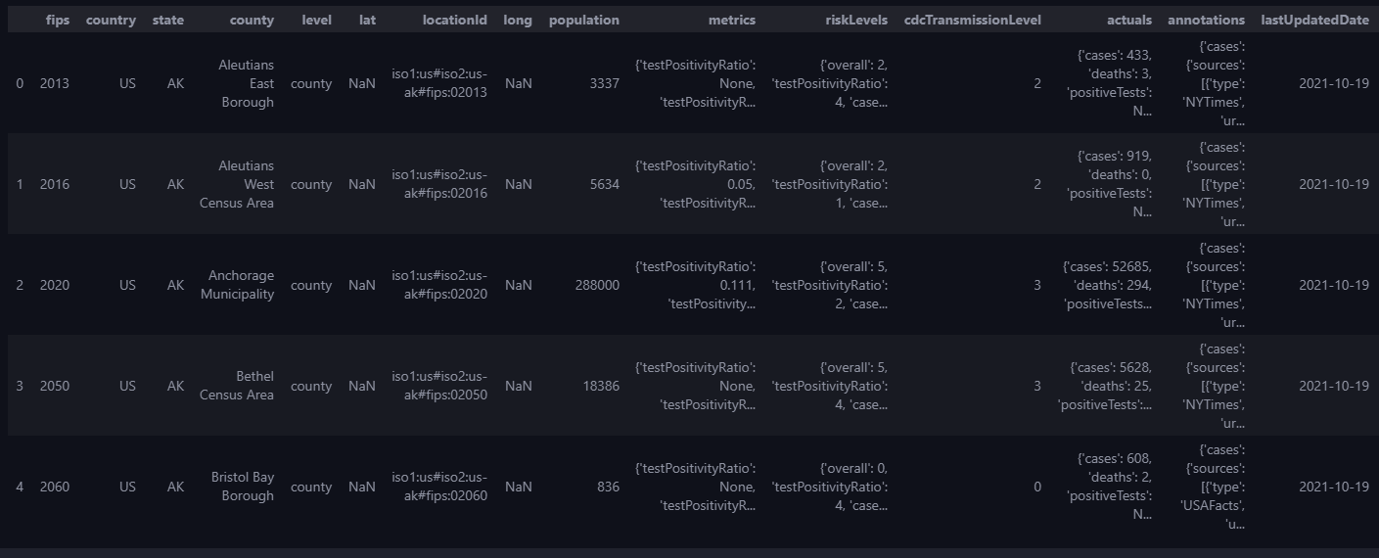
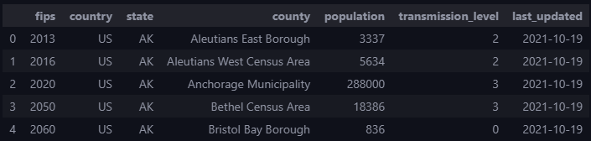
Transform: Data Wrangling pt.1
Json file before cleaning
Json file after cleaning
Notes:
Anthony
Json file: dropped columns with NaN values such as “lat” or contained dictionaries which was not useful.. Leaving us with a handful of useful data. We ran into an issue with two of the columns throwing errors for “undefined columns”.. The solution was to rename and lowercase the names of the columns..

Slide 4

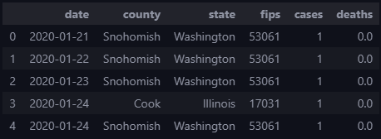

Data Wrangling pt. 2
Reading csv file
Notes:
Cecilia
Csv file: coded the fips column to a int instead of a float.. Then we dropped the null values to keep only usable data..

Slide 5
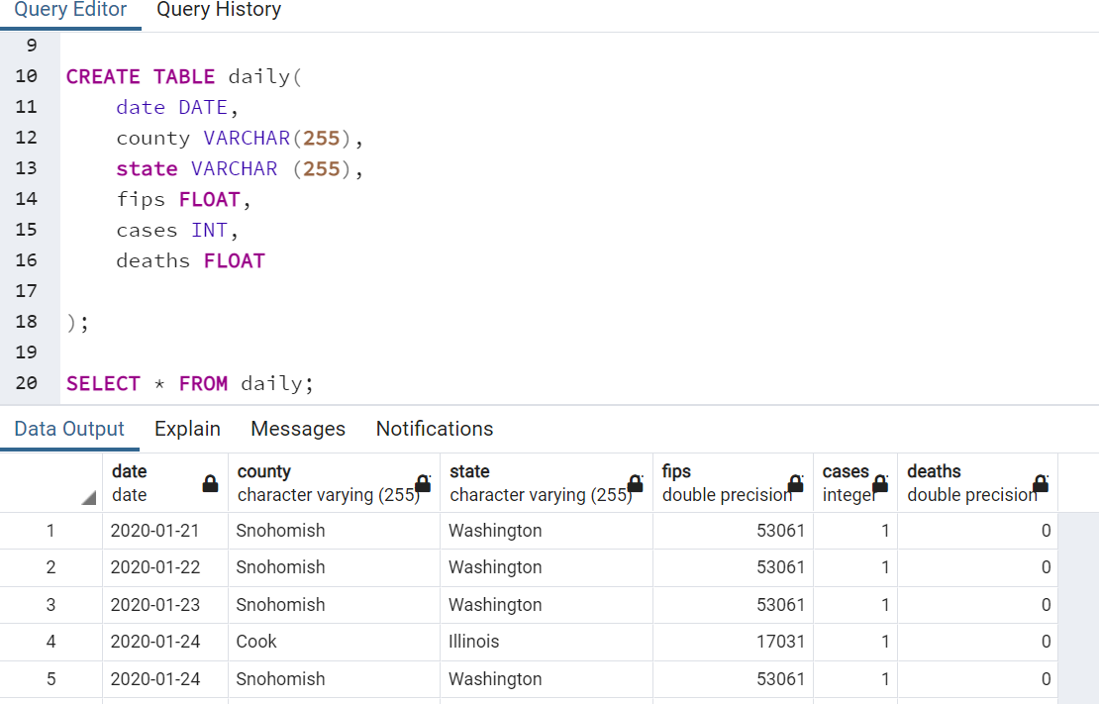
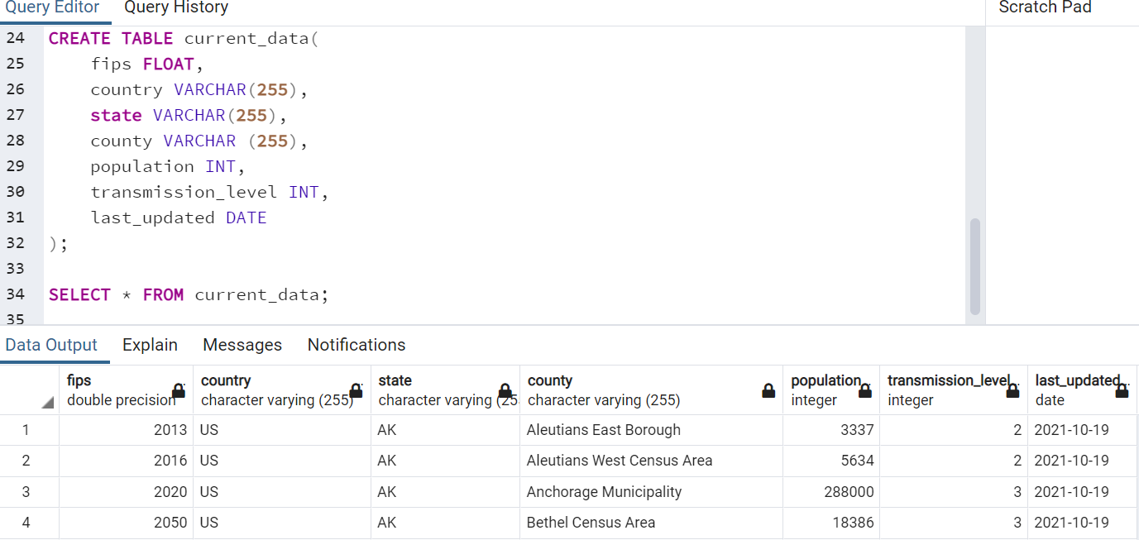

Confirm data has been added by using pgAdmin
Reading table “daily”
Reading table “current_data”
Connect to local database and Use pandas to load csv/json converted DataFrame into database
Notes:
Sahar
We utilized postgres to do our loading … we chose postgres because we wanted a challenge and it is a common sql database so what better database to use

Slide 6
Thank You!

